Slide 1
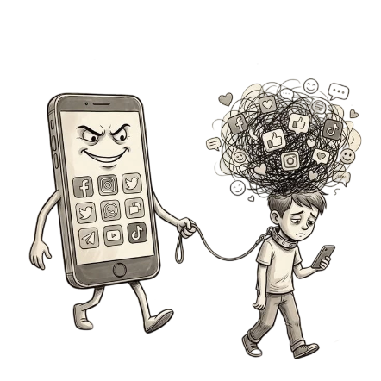
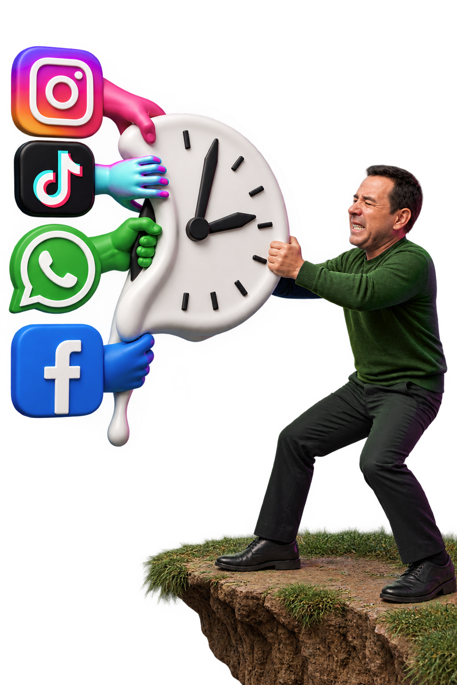
Beyond the
Screen
YOU ARE NOT USING SOCIAL MEDIA
SOCAIL MEDIA IS USING YOU
SOCIAL MEDIA, DOPAMINE AND PRODUCTIVITY |DATA ANALYSIS
1

Slide 2
Agenda
1
2
3
Metadata
Exploration
Project overview
Python Workflow
4
5
6
SQL Analysis
Dashboard 1
Dashboard 2
7
8
9
Dashbord 3
Insights
Conclusion
2

Slide 3
Project Overview
Project overview
Main Objectives
This project analyzes how social media usage affects users’ productivity, focus, sleep, and digital wellbeing.
Using data about social media habits, productivity and cognition, sleep patterns, mental wellbeing, and demographic characteristics,
the project aims to identify important patterns and relationships between digital behavior and daily performance.
  Analyze social media usage patterns.
  Explore its impact on productivity and focus.
  Examine the relationship with sleep and wellbeing.
  Identify demographic differences in digital wellbeing and addiction risk.
  SQL — Data analysis and answering business questions.
  Python — Data cleaning, preprocessing, and exploratory analysis.
  Power BI — Interactive dashboards, KPIs, and data visualization.
  Excel-- Interactive dashboards.
Tools Used
Project Structure
The analysis is divided into four main topics:
  Social Media Usage & Habits
  Social Media & Productivity
  Social Media, Sleep & Mental Wellbeing
  Digital Wellbeing & User Profile
SOCIAL MEDIA, DOPAMINE AND PRODUCTIVITY |DATA ANALYSIS
3

Slide 4
Metadata Exploration
Dataset
Records
Social Media, Productivity & Digital Wellbeing
300 Participants
This dataset explores the relationship between social media usage and its potential impact on productivity and cognitive performance. It contains information about users’ social media habits, daily screen time, work/study patterns, attention span, deep-work duration, task completion, and productivity-related behaviors. The dataset also includes demographic and behavioral attributes that provide additional context for analyzing productivity patterns.
SOCIAL MEDIA, DOPAMINE AND PRODUCTIVITY |DATA ANALYSIS
4

Slide 5
Python Workflow
1.Data Loading
2.Data Exploration
3.Data Cleaning
5.Data Preparation
Checked the dataset shape, columns, data types, missing values, duplicates, and statistics..
Handled data quality issues and removed unnecessary columns.
Loaded the raw
dataset using Pandas.
Split the cleaned dataset into 5 related tables for analysis and Power BI.
SOCIAL MEDIA, DOPAMINE AND PRODUCTIVITY |DATA ANALYSIS
5

Slide 6
Python Workflow
5.Data Validation
6.Data Export
7.Feature Engineering
8.Encoding
Checked unique values, invalid values, and potential outliers.
Saved the cleaned tables as CSV files for use in Power BI.
Created meaningful features such as:
  Social Media Usage Level
  Addiction Risk Level
  Sleep Level
  Non-Social Screen Time
  Reward Seeking Level
Invert ctegorical data into a numeriacal format suitable for analysis
SOCIAL MEDIA, DOPAMINE AND PRODUCTIVITY |DATA ANALYSIS
6

Slide 7
SQL Analysis
7
SOCIAL MEDIA, DOPAMINE AND PRODUCTIVITY |DATA ANALYSIS

Slide 8
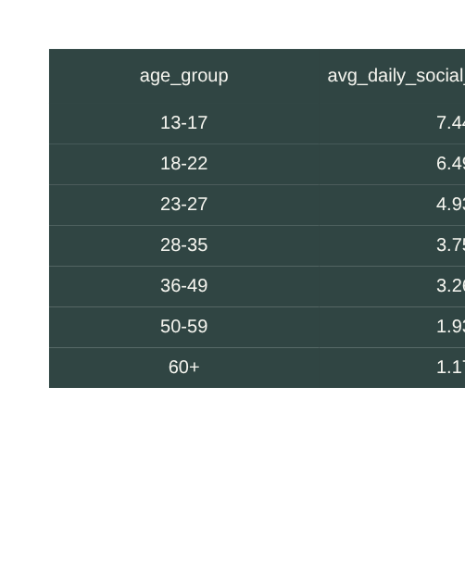
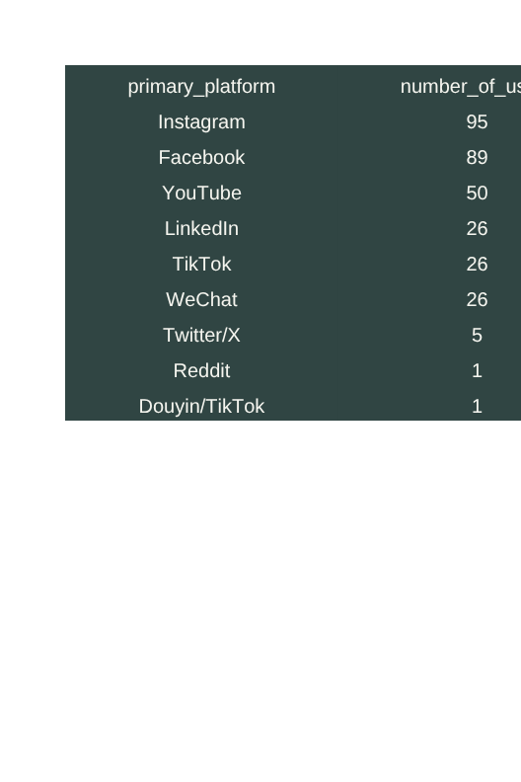
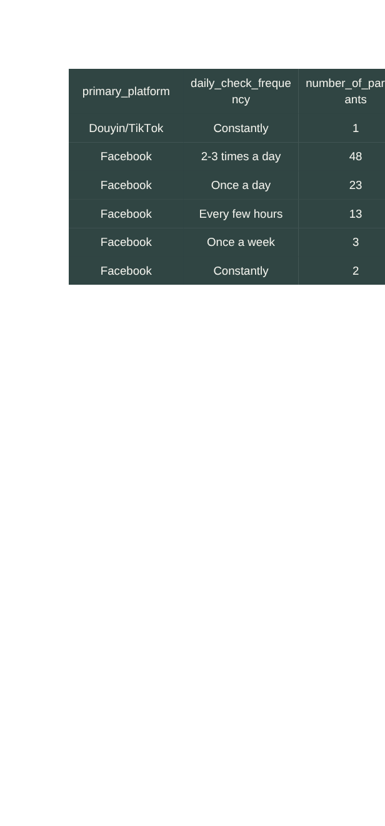
Topic 1 :Social Media Usage & Habits
--1. Average daily social media usage by age group
SELECT
p.age_group,
AVG(m.avg_daily_sm_hours) AS avg_daily_social_media_hours
FROM Participant p
JOIN Fact_User_Metrics m
ON p.participant_id = m.participant_id
GROUP BY p.age_group
ORDER BY avg_daily_social_media_hours DESC;
--2. Which social media platform is the
most preferred?
3. How frequently do users check social media across
different primary platforms?
SELECT primary_platform,
daily_check_frequency,
COUNT(*) AS number_of_participants
FROM SocialMedia_Habits
GROUP BY primary_platform, daily_check_frequency
ORDER BY primary_platform,number_of_participants DESC;
SELECT
primary_platform,
COUNT(*) AS number_of_users
FROM SocialMedia_Habits
GROUP BY primary_platform
ORDER BY number_of_users DESC;
SOCIAL MEDIA, DOPAMINE AND PRODUCTIVITY |DATA ANALYSIS
8

Slide 9
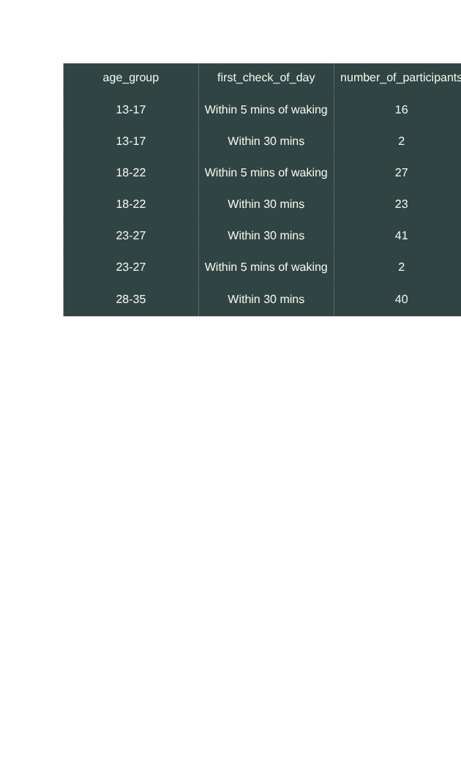
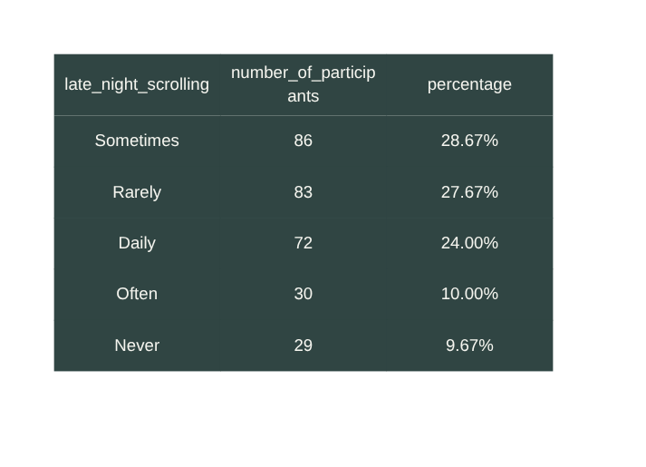
Topic 1 :Social Media Usage & Habits
--4. How does first-check-of-day behavior vary by age group?
SELECT
p.age_group,
AVG(m.avg_daily_sm_hours) AS avg_daily_social_media_hours
FROM Participant p
JOIN Fact_User_Metrics m
ON p.participant_id = m.participant_id
GROUP BY p.age_group
ORDER BY avg_daily_social_media_hours DESC;
--5. How common is late-night scrolling across participants?
SELECT late_night_scrolling,
COUNT(*) AS number_of_participants,
CONCAT(
CAST(
COUNT(*) * 100.0 / SUM(COUNT(*)) OVER()
AS DECIMAL(5,2) ), '%' ) AS percentage
FROM SocialMedia_Habits
GROUP BY late_night_scrolling
ORDER BY number_of_participants DESC;
SOCIAL MEDIA, DOPAMINE AND PRODUCTIVITY |DATA ANALYSIS
9

Slide 10
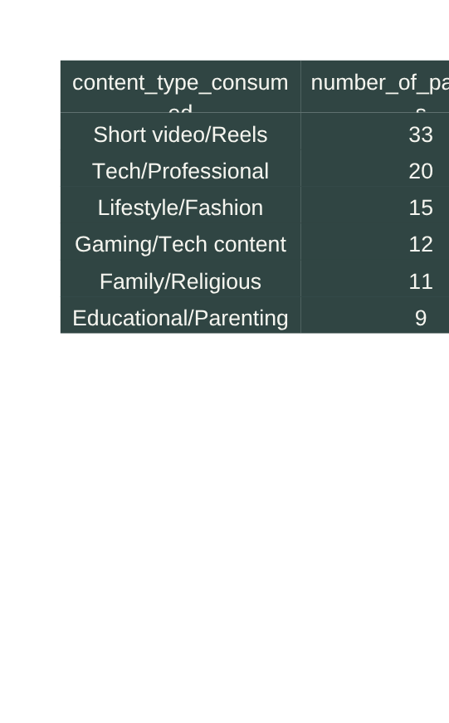
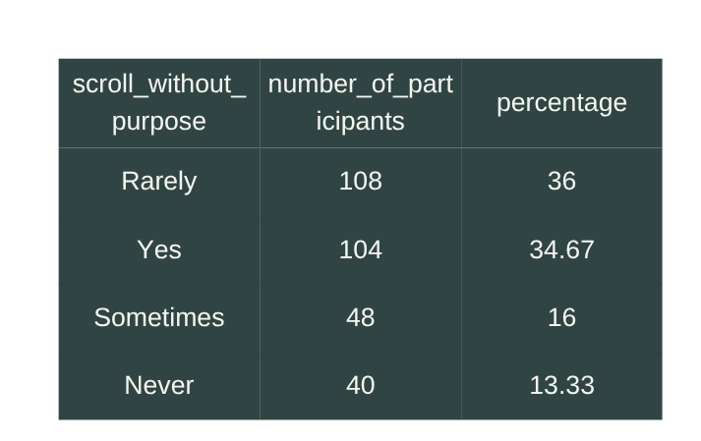
Topic 1 :Social Media Usage & Habits
--6. Which content types are consumed most frequently?
SELECT TOP(10)
content_type_consumed,
COUNT(*) AS number_of_participants
FROM SocialMedia_Habits
GROUP BY content_type_consumed
ORDER BY number_of_participants DESC;
--7. How frequently do people scroll without a specific purpose?
SELECT
scroll_without_purpose,
COUNT(*) AS number_of_participants,
CAST(
COUNT(*) * 100.0 / SUM(COUNT(*)) OVER()
AS DECIMAL(5,2)
) AS percentage
FROM SocialMedia_Habits
GROUP BY scroll_without_purpose
ORDER BY number_of_participants DESC;
SOCIAL MEDIA, DOPAMINE AND PRODUCTIVITY |DATA ANALYSIS
10

Slide 11
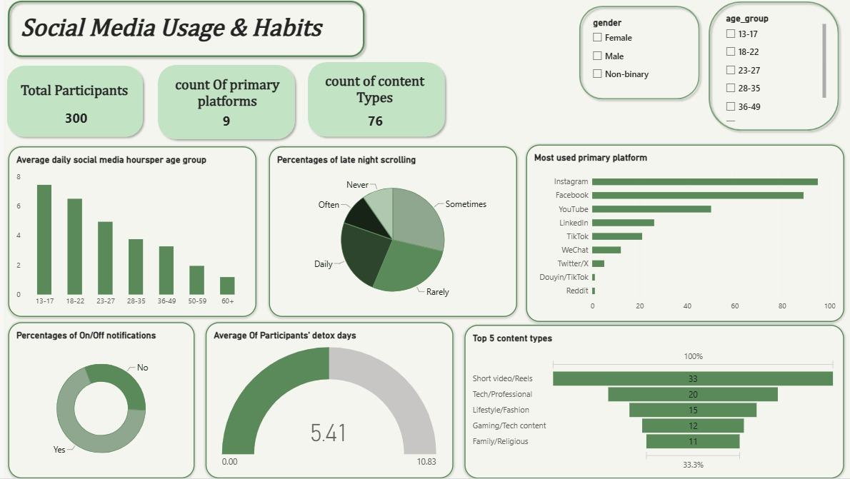
11

Slide 12
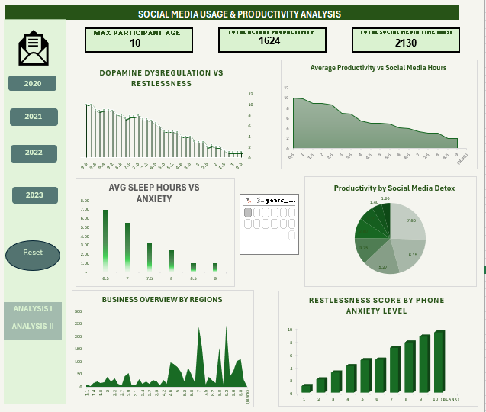
12

Slide 13
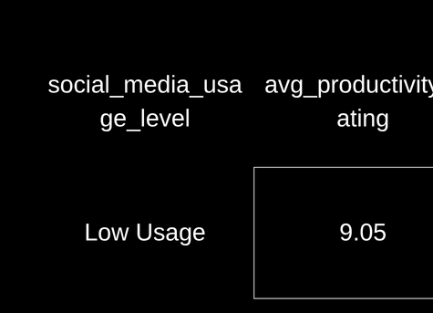
Topic 2 :Social Media & Productivity
Does higher daily social media usage relate to lower productivity?
SELECT
CASE
WHEN avg_daily_sm_hours < 3 THEN 'Low Usage'
WHEN avg_daily_sm_hours < 6 THEN 'Medium Usage'
ELSE 'High Usage'
END AS social_media_usage_level,
ROUND( AVG(CAST(productivity_self_rating AS FLOAT)),2) AS avg_productivity_rating
FROM Fact_User_Metrics
GROUP BY
CASE
WHEN avg_daily_sm_hours < 3 THEN 'Low Usage'
WHEN avg_daily_sm_hours < 6 THEN 'Medium Usage'
ELSE 'High Usage'
END
ORDER BY avg_productivity_rating DESC;
SOCIAL MEDIA, DOPAMINE AND PRODUCTIVITY |DATA ANALYSIS
13

Slide 14




Topic 2 :Social Media & Productivity
2 How does average screen time vary across productivity decline levels?
SELECT
productivity_self_rating,
ROUND(AVG(avg_daily_screen_time_hours), 2) AS avg_screen_time
FROM Fact_User_Metrics
GROUP BY productivity_self_rating
ORDER BY avg_screen_time DESC;
3 Is social media use during work/study associated with productivity decline?
SELECT
sm_during_work_study, productivity_decline_score,
COUNT(*) AS participants FROM SocialMedia_Habits s
JOIN Productivity_Cognition p ON s.participant_id = p.participant_id
GROUP BY
sm_during_work_study, productivity_decline_score
ORDER BY sm_during_work_study, participants DESC;
SOCIAL MEDIA, DOPAMINE AND PRODUCTIVITY |DATA ANALYSIS
14

Slide 15




Topic 2 :Social Media & Productivity
4 Does higher task-switching frequency relate to greater productivity decline?
SELECT
task_switching_frequency,
productivity_decline_score,COUNT(*) AS participants
FROM Productivity_Cognition
GROUP BY
task_switching_frequency,
productivity_decline_score
ORDER BY task_switching_frequency;
5 How does difficulty maintaining focus vary with social media usage?
SELECT CASE
WHEN avg_daily_sm_hours < 4 THEN 'Low'
WHEN avg_daily_sm_hours < 5.5 THEN 'Medium'
WHEN avg_daily_sm_hours < 6.5 THEN 'High'
ELSE 'Very High' END AS usage_level,
difficulty_maintaining_focus,
COUNT(*) AS participants
FROM Fact_User_Metrics fOIN Productivity_Cognition p
ON f.participant_id = p.participant_id GROUP BY CASE
WHEN avg_daily_sm_hours < 4 THEN 'Low'
WHEN avg_daily_sm_hours < 5.5 THEN 'Medium'
WHEN avg_daily_sm_hours < 6.5 THEN 'High'
ELSE 'Very High' END, difficulty_maintaining_focus;
SOCIAL MEDIA, DOPAMINE AND PRODUCTIVITY |DATA ANALYSIS
15

Slide 16




Topic 2 :Social Media & Productivity
How does attention span vary across different social media usage levels?
6 Does deep-work duration decrease as social media usage increases?
SELECT CASE WHEN avg_daily_sm_hours < 4 THEN 'Low'
WHEN avg_daily_sm_hours < 5.5 THEN 'Medium'
WHEN avg_daily_sm_hours < 6.5 THEN 'High'
ELSE 'Very High' END AS usage_level,
ROUND(AVG(attention_span_minutes), 2) AS avg_attention_span
FROM Fact_User_Metrics
GROUP BY CASE WHEN avg_daily_sm_hours < 4 THEN 'Low'
WHEN avg_daily_sm_hours < 5.5 THEN 'Medium'
WHEN avg_daily_sm_hours < 6.5 THEN 'High'
ELSE 'Very High' END
ORDER BY avg_attention_span DESC;
SELECT
CASE
WHEN avg_daily_sm_hours < 4 THEN 'Low'
WHEN avg_daily_sm_hours < 5.5 THEN 'Medium'
WHEN avg_daily_sm_hours < 6.5 THEN 'High'
ELSE 'Very High' END AS usage_level,
ROUND(AVG(deep_work_duration_minutes), 2) AS avg_deep_work
FROM Fact_User_Metrics GROUP BY CASE
WHEN avg_daily_sm_hours < 4 THEN 'Low'
WHEN avg_daily_sm_hours < 5.5 THEN 'Medium'
WHEN avg_daily_sm_hours < 6.5 THEN 'High'
ELSE 'Very High' END
ORDER BY avg_deep_work DESC;
SOCIAL MEDIA, DOPAMINE AND PRODUCTIVITY |DATA ANALYSIS
16

Slide 17
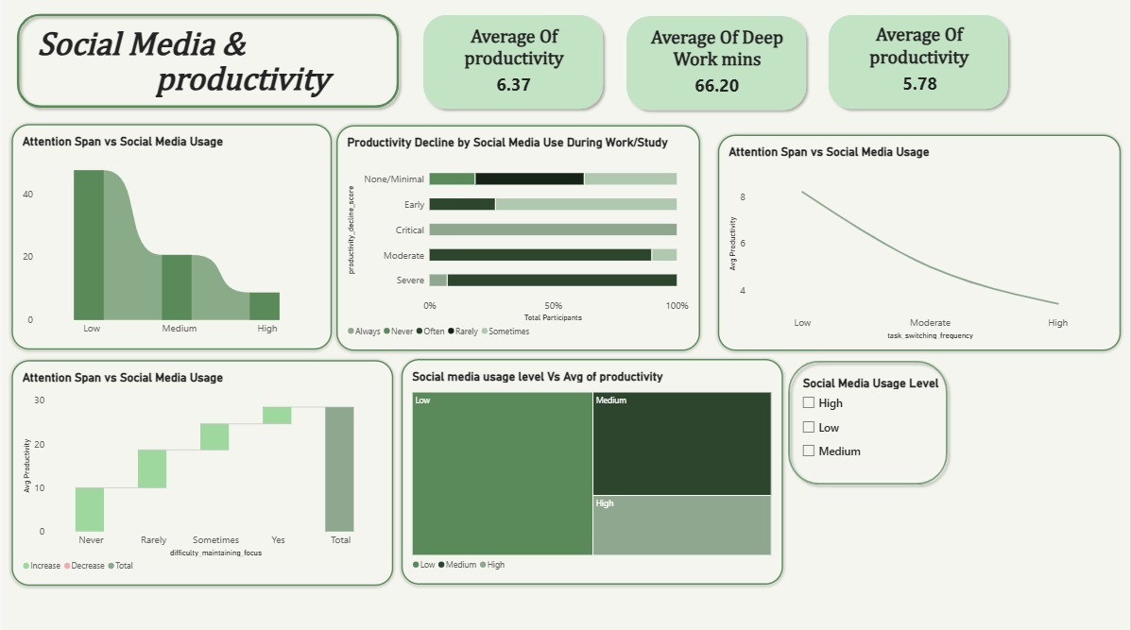
17

Slide 18

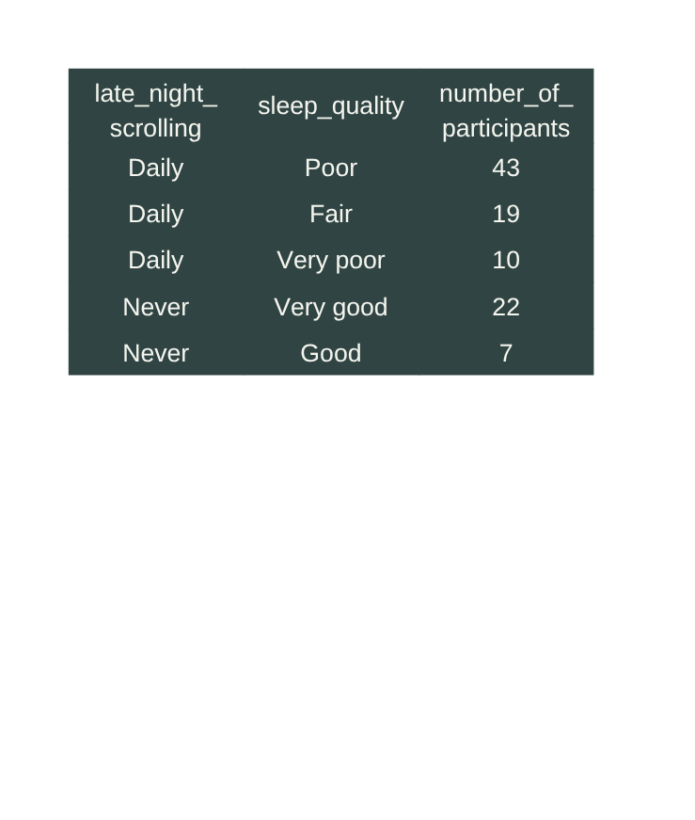
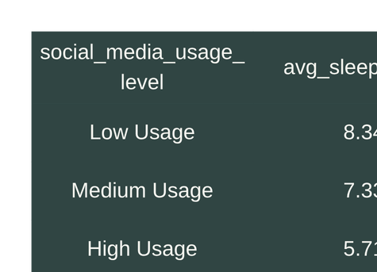

Topic 3 :Social Media, Sleep & Mental Wellbeing
-- 1. How does average sleep duration vary with
daily social media usage?
SELECT
CASE WHEN avg_daily_sm_hours < 3 THEN 'Low Usage'WHEN avg_daily_sm_hours < 6 THEN 'Medium Usage'ELSE 'High Usage'END AS social_media_usage_level,ROUND(AVG(avg_sleep_hours), 2) AS avg_sleep_hours
FROM Fact_User_Metrics
GROUP BYCASEWHEN avg_daily_sm_hours < 3 THEN 'Low Usage'WHEN avg_daily_sm_hours < 6 THEN 'Medium Usage'ELSE 'High Usage'ENDORDER BY avg_sleep_hours DESC;
2. Is late-night scrolling associated with lower sleep quality?
SELECT
s.late_night_scrolling,
m.sleep_quality,
COUNT(*) AS number_of_participants
FROM SocialMedia_Habits s
JOIN Mental_Detox m
ON s.participant_id = m.participant_id
GROUP BY
s.late_night_scrolling,
m.sleep_quality
ORDER BY
s.late_night_scrolling,
number_of_participants DESC;
SOCIAL MEDIA, DOPAMINE AND PRODUCTIVITY |DATA ANALYSIS
18

Slide 19
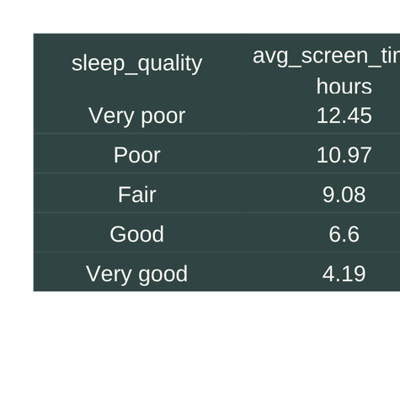


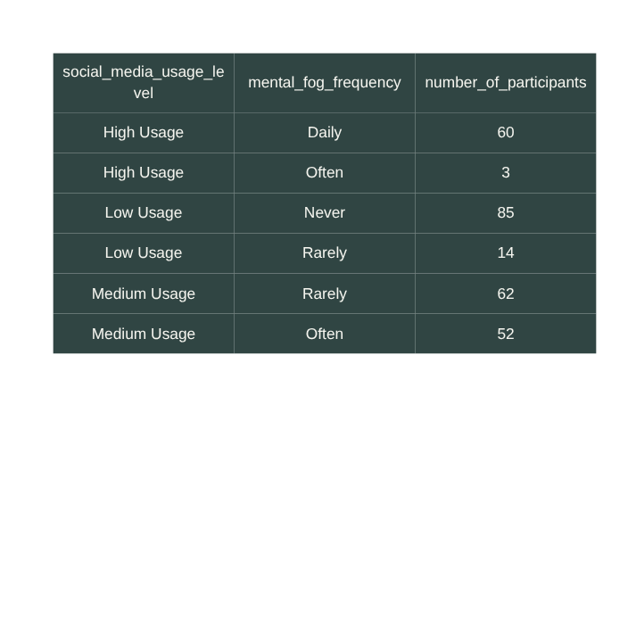
Topic 3 :Social Media, Sleep & Mental Wellbeing
4. Is mental fog more frequent among people with higher social media usage?
SELECT
CASE
WHEN m.avg_daily_sm_hours < 3 THEN 'Low Usage'
WHEN m.avg_daily_sm_hours < 6 THEN 'Medium Usage'
ELSE 'High Usage'
END AS social_media_usage_level,
md.mental_fog_frequency,
COUNT(*) AS number_of_participants
FROM Fact_User_Metrics m
JOIN Mental_Detox md
ON m.participant_id = md.participant_id
GROUP BY CASE
WHEN m.avg_daily_sm_hours < 3 THEN 'Low Usage'
WHEN m.avg_daily_sm_hours < 6 THEN 'Medium Usage'
ELSE 'High Usage' END, md.mental_fog_frequency
ORDER BY social_media_usage_level, number_of_participants DESC;
3. Does screen time vary across sleep-quality levels?
SELECT
md.sleep_quality,
ROUND(AVG(m.avg_daily_screen_time_hours), 2)
AS avg_screen_time_hours
FROM Mental_Detox md
JOIN Fact_User_Metrics m
ON md.participant_id = m.participant_id
GROUP BY md.sleep_quality
ORDER BY avg_screen_time_hours DESC;
SOCIAL MEDIA, DOPAMINE AND PRODUCTIVITY |DATA ANALYSIS
19

Slide 20

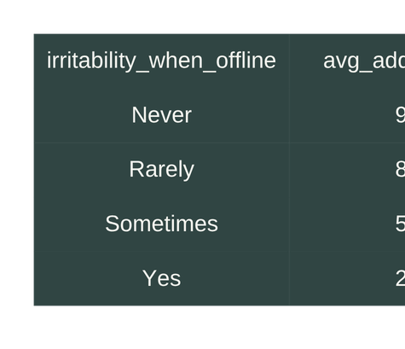
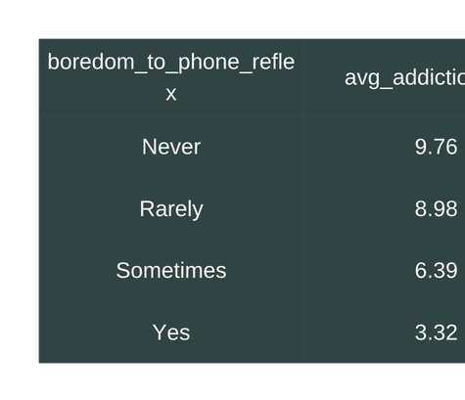
Topic 3 :Social Media, Sleep & Mental Wellbeing
5. Is irritability when offline associated with social media addiction risk?
SELECT
md.irritability_when_offline,
ROUND(AVG(m.sm_addiction_risk_score), 2) AS avg_addiction_risk
FROM Fact_User_Metrics m
JOIN Mental_Detox md
ON m.participant_id = md.participant_id
GROUP BY md.irritability_when_offline
ORDER BY avg_addiction_risk DESC;
6. Is boredom-to-phone reflex associated with addiction risk?
SELECT
md.boredom_to_phone_reflex,
ROUND(AVG(m.sm_addiction_risk_score), 2) AS avg_addiction_risk
FROM Fact_User_Metrics m
JOIN Mental_Detox md
ON m.participant_id = md.participant_id
GROUP BY md.boredom_to_phone_reflex
ORDER BY avg_addiction_risk DESC;
SOCIAL MEDIA, DOPAMINE AND PRODUCTIVITY |DATA ANALYSIS
20

Slide 21
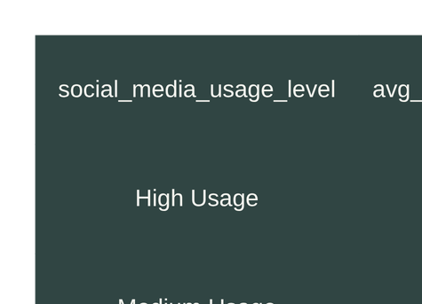
Topic 3 :Social Media, Sleep & Mental Wellbeing
-- 7. How does digital wellbeing score vary across social media usage levels?
SELECT
CASE
WHEN avg_daily_sm_hours < 3 THEN 'Low Usage'
WHEN avg_daily_sm_hours < 6 THEN 'Medium Usage'
ELSE 'High Usage'
END AS social_media_usage_level,
ROUND(AVG(digital_wellbeing_score), 2) AS avg_digital_wellbeing_score
FROM Fact_User_Metrics
GROUP BY
CASE
WHEN avg_daily_sm_hours < 3 THEN 'Low Usage'
WHEN avg_daily_sm_hours < 6 THEN 'Medium Usage'
ELSE 'High Usage'
END
ORDER BY avg_digital_wellbeing_score DESC;
SOCIAL MEDIA, DOPAMINE AND PRODUCTIVITY |DATA ANALYSIS
21

Slide 22
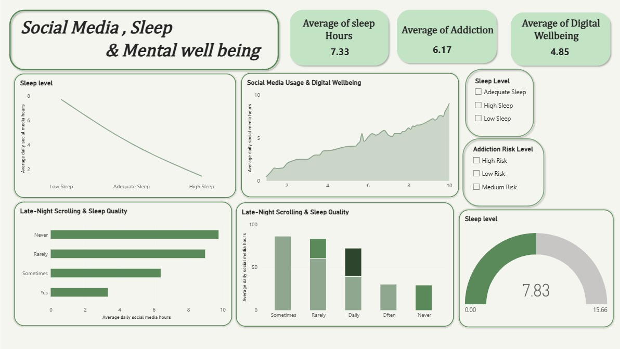
22

Slide 23
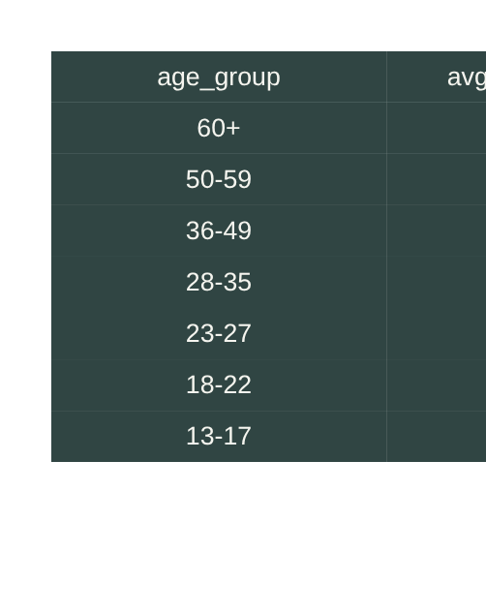
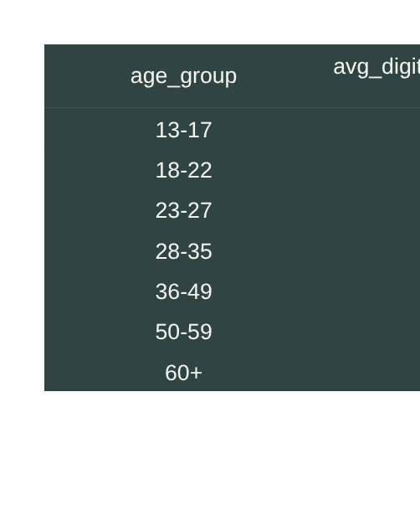
Topic 4 :Digital Wellbeing & User Profile
--1. How does social media addiction risk vary by age group?
SELECT
p.age_group,
AVG(m.sm_addiction_risk_score) AS avg_addiction_risk
FROM Participant p
JOIN Fact_User_Metrics M
ON p.participant_id = m.participant_id
GROUP BY p.age_group
ORDER BY avg_addiction_risk DESC;
--2. How does digital wellbeing score vary by age group?
SELECT
p.age_group,
AVG(m.digital_wellbeing_score) AS avg_digital_wellbeing_score
FROM Participant p
JOIN Fact_User_Metrics m
ON p.participant_id = m.participant_id
GROUP BY p.age_group
ORDER BY avg_digital_wellbeing_score DESC;
SOCIAL MEDIA, DOPAMINE AND PRODUCTIVITY |DATA ANALYSIS
23

Slide 24
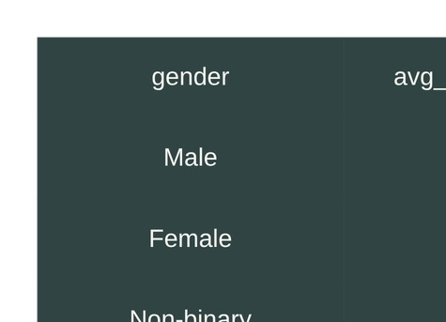

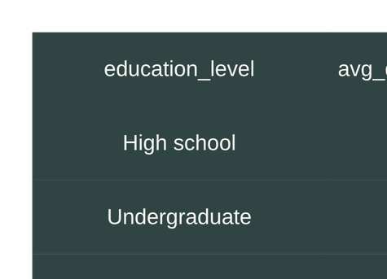
Topic 4 :Digital Wellbeing & User Profile
3. Does gender show differences in social media addiction risk?
SELECT
p.gender,
AVG(m.sm_addiction_risk_score) AS avg_addiction_risk
FROM Participant p
JOIN Fact_User_Metrics m
ON p.participant_id = m.participant_id
GROUP BY p.gender
ORDER BY avg_addiction_risk DESC;
--4. How does digital wellbeing vary by education level?
SELECT
p.education_level,
AVG(m.digital_wellbeing_score) AS avg_digital_wellbeing_score
FROM Participant p
JOIN Fact_User_Metrics m
ON p.participant_id = m.participant_id
GROUP BY p.education_level
ORDER BY avg_digital_wellbeing_score DESC;
24
SOCIAL MEDIA, DOPAMINE AND PRODUCTIVITY |DATA ANALYSIS

Slide 25
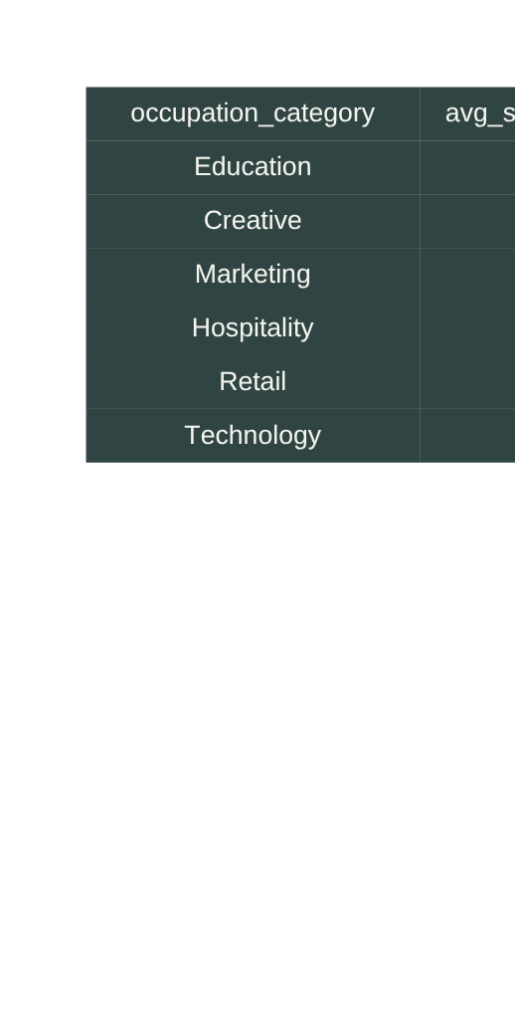
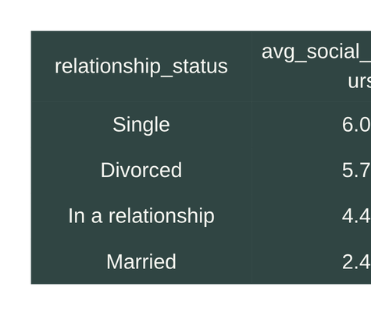
Topic 4 :Digital Wellbeing & User Profile
5. Which occupation categories have the highest average screen time?
SELECT
p.occupation_category,
AVG(m.avg_daily_screen_time_hours) AS avg_screen_time_hours
FROM Participant p
JOIN Fact_User_Metrics m
ON p.participant_id = m.participant_id
GROUP BY p.occupation_category
ORDER BY avg_screen_time_hours DESC;
6 Does relationship status relate to social media usage?
SELECT
p.relationship_status,
AVG(m.avg_daily_sm_hours) AS avg_social_media_hours
FROM Participant p
JOIN Fact_User_Metrics m
ON p.participant_id = m.participant_id
GROUP BY p.relationship_status
ORDER BY avg_social_media_hours DESC;
SOCIAL MEDIA, DOPAMINE AND PRODUCTIVITY |DATA ANALYSIS
25

Slide 26
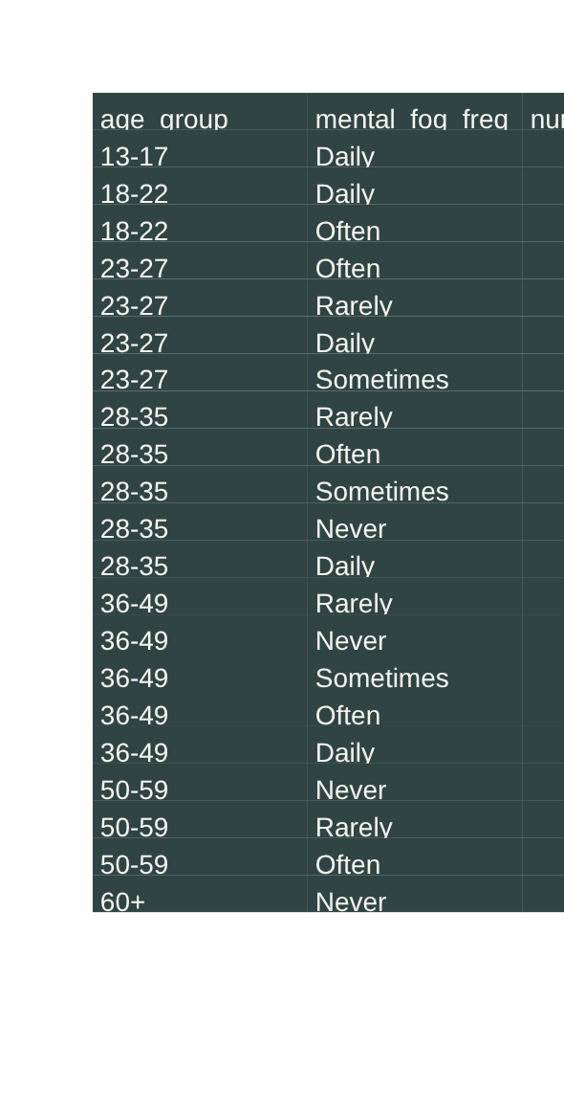
Topic 4 :Digital Wellbeing & User Profile
7. How does mental fog frequency vary across age groups?
SELECT
p.age_group,
md.mental_fog_frequency,
COUNT(*) AS number_of_participants
FROM Participant p
JOIN Mental_Detox md
ON p.participant_id = md.participant_id
GROUP BY
p.age_group,
md.mental_fog_frequency
ORDER BY
p.age_group,
number_of_participants DESC;
Guild A Display
SOCIAL MEDIA, DOPAMINE AND PRODUCTIVITY |DATA ANALYSIS
26

Slide 27
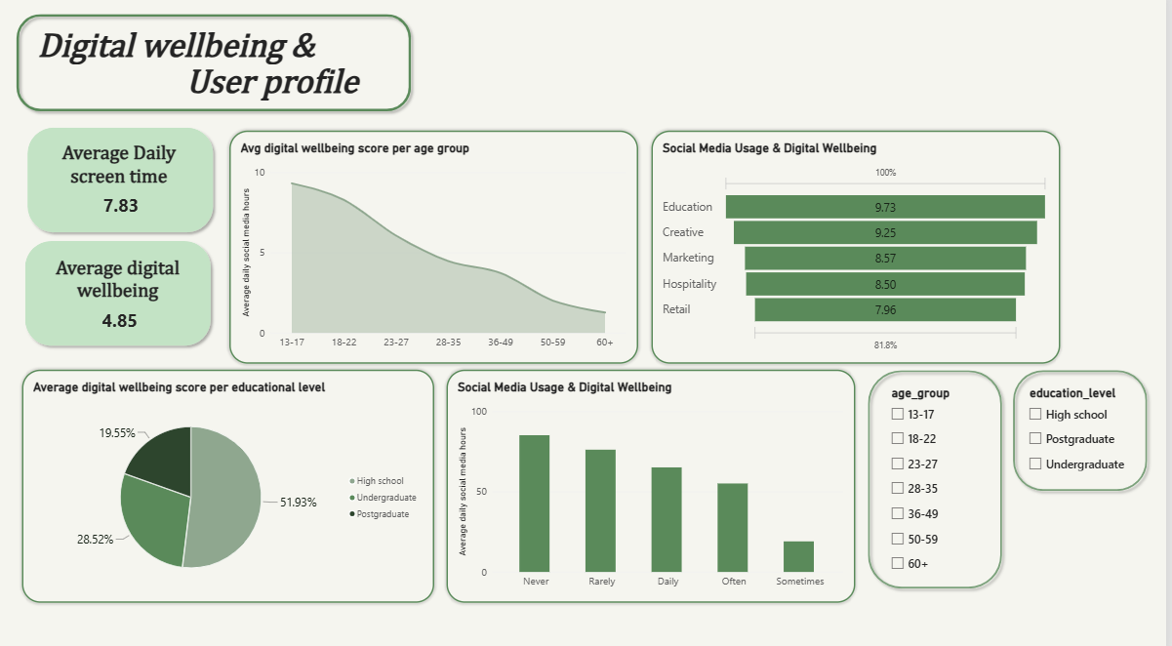
27

Slide 28
INSIGHTS
1. Social Media Usage & Habits
Higher social media usage can be compared with differences in screen time and productivity.
Frequent checking and purposeless scrolling highlight different patterns of social media use.
Late-night scrolling can be examined in relation to sleep duration and sleep quality.
1. Social Media Usage & Habits
Higher social media usage can be compared with differences in screen time and productivity.
Frequent checking and purposeless scrolling highlight different patterns of social media use.
Late-night scrolling can be examined in relation to sleep duration and sleep quality.
2. Productivity & Cognition
Social media usage levels can be compared with productivity and tasks completed per day.
Attention span and deep-work duration can be analyzed across different usage levels.
Task switching and mind wandering provide additional indicators of focus and productivity patterns.
3. Sleep & Digital Wellbeing
Sleep patterns can be compared across different levels of social media usage.
Sleep quality can be examined alongside addiction risk.
Digital wellbeing can be compared with social media usage and behavioral patterns.
4. Addiction Risk
Users can be categorized into Low, Medium, and High Addiction Risk.
Addiction risk can be analyzed in relation to social media usage intensity.
Reward-seeking behavior, boredom-to-phone reflex, and mood dependency can provide additional behavioral context.
5. Demographic Patterns
Social media habits can be compared across age groups, education levels, and employment status.
Productivity and addiction risk can also be explored across different demographic groups.
Overall Insight
SOCIAL MEDIA, DOPAMINE AND PRODUCTIVITY |DATA ANALYSIS
28

Slide 29
. This analysis provides a clearer understanding of how social media habits may relate to productivity, cognitive performance, sleep, and digital wellbeing. By examining usage patterns, behavioral factors, and demographic characteristics, the project highlights key factors that can be used to understand social media engagement and addiction risk.
.Overall, the analysis can help identify behavioral patterns and support better digital habits, healthier screen-time management, and improved productivity.
Conclusion
SOCIAL MEDIA, DOPAMINE AND PRODUCTIVITY |DATA ANALYSIS
29

Slide 30
Prepared by
Mariam Mohep Ebrahim
Roaa Ahmed Mohamed
Aml Razk Hosni
Hasnaa Ahmed Mahmoud
Poula Gerges
SOCIAL MEDIA, DOPAMINE AND PRODUCTIVITY |DATA ANALYSIS
30

Slide 31
THANK YOU
SOCIAL MEDIA, DOPAMINE AND PRODUCTIVITY |DATA ANALYSIS
31

